Slide 1
Treatment of Abandoned Mine Drainage
An Overview of Treatment Options for AMD
Lessons Prepared by Trout Unlimited
With Funds from Pennsylvania Department of Environmental Protection
Notes:
The objective of this lesson is to provide information about the treatment options for abandoned mine drainage, how they work, and other forms of remediation for AMD.
Important points for students:
This lesson will focus on the many options for AMD treatment.

Slide 2
Regulations of Mining
1977 – Surface Mining Control and Reclamation Act (SMCRA)
SMCRA regulated current mining and worked to reclaim abandoned mines
Establish the Office of Service Mining Reclamation and Enforcement
It also establishes funds for the clean up of AMD
Notes:
Prior to 1977 there were no regulations on how mining companies could mine coal or what had to be done after they were finished mining.
In 1977 federal regulations were passed that established many things.
First of these regulations was to be sure that future mining did not create more drainages.
The second was to reclaim abandoned mines
Important points for students:
SMCRA regulates current mining and works to clean-up historic mining

Slide 3
Office of Surface Mining
The Office of Surface Mining
- Promulgate regulations
- Funds state regulatory and reclamation efforts
- Ensures consistency among state regulatory programs
SMCRA was and is crucial to the improvement and cleanup of environments affected by AMD
Notes:
SMCRA created the Office of Surface Mining (OSM)
This agency helps to write the regulations, fund and regulate state agencies that regulate the industry.
OSM works to be sure that current mining does not create impairments through these actions
Without SMCRA mining would still be creating drainages and much of the work that has been done to clean up AMD is funded through this bill.
Important points for students:
The implementation of SMCRA is and was crucial to the improvement of water quality and environments affected by AMD
Questions for Students:
What does promulgate mean?
What is the importance in having

Slide 4
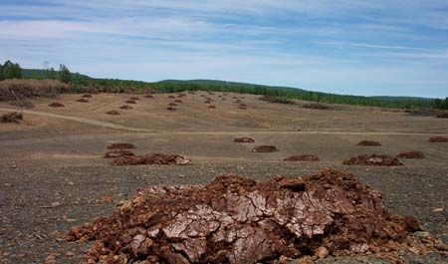
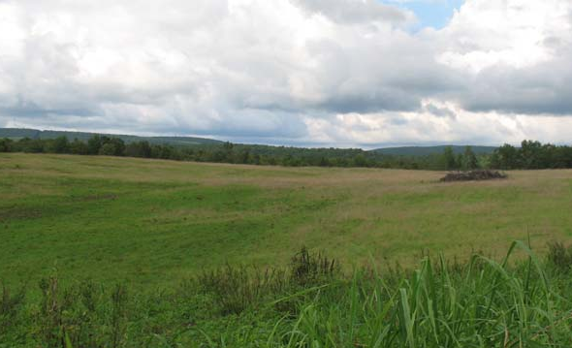
Land Reclamation
Land Reclamation works to return previously mined areas to the condition they were previously in
This includes regrading abandoned surface mining to decrease drainages and remove dangerous mine features
This can also include closing mine shafts and other land related clean up
On the left is a partially reclaimed strip mine. The land has been regraded and soil additives are seen in piles. On the right we see the same area after grass has grown on the site. Provided by TU Staff.
Notes:
Reclamation is the process of returning land, which has been adversely affected by past coal mining, as close to its original form as possible.
Sometimes this means simply regrading land to remove mine features.
It can also include removal of refuse piles, and revegetation of surface mines
While the main effort of land reclamation is to return the land to the condition it was in previously this often times removes or decrease drainages as well.
This is because as water flows more naturally over the ground with vegetation less water contacts the pyrite in the soil. This means less drainage is made.
This also decreases sedimentation as well as less soil erodes when the soil is vegetated.
Important points for students:
Reclamation returns the land to its original condition and decreases AMD.

Slide 5
Remining
Remining utilizes coal which still remains in abandoned mines
Coal companies can generate money by mining this coal and sell it for a profit
As they mine they added alkalinity, regrade and take other precautions so that these sites do not create drainages
This allows mine drainage to be cleaned-up permanently and generally occurs at no cost to the taxpayer
Notes:
Remining utilizes the coal which often times remains in historic coal mines.
Due to a lack of technologies often times coal remains in these historic mines
This coal allows the coal company to generate money as they mine the coal
As they mine the company adds alkalinity, and regrade the sites. This along with other precautions remove the source of pollution
This permanently removes this pollution
This also is done at no cost to government, and tax payer
This also provides coal for use with out disturbing new areas.
Important points for students:
Remining provided permanent removal of pollution.

Slide 6
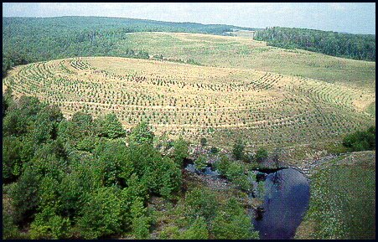
The remining operation at Benbush was 211 acres, daylighted old auger holes from previous surface mining and eliminated old highwalls. Picture taken March 1983.
The Benbush remining job is vegetated with grasses and trees. Picture taken September 1990.
Notes:
http://www.wvu.edu/~agexten/landrec/remining.htm
These are pictures taken in West Virginia; however, the process is still the same and it shows the before and after pictures of a site that has been successfully re-mined and reclaimed.
Important points for students:
This whole process took 7 years which illustrates the time it takes to remine and restore sites which have been negatively affected by historic mining.
Questions for Students:
What would have/are some of the benefits of this remining project? (refer to previous slide)
Ask students if they know of any sites where they might have seen remining.

Slide 7
Treatment
Some mines are cleaned-up by treating the water that comes from them
This requires that the pH of the water is raised
As the pH rises the metals can no longer stay dissolved
The metals then precipitate and can be settled out allowing clean water to flow out
Notes:
The other option is treat the water after it has left the mine or refuse area.
The general idea behind treatment is raise the pH of the water
Once the pH has raised metals can not stay dissolved in the water and become solids or precipitates
These metals can be allowed to settle and be removed from the water
The result is water with a higher pH, less metals and generally higher alkalinity
Other additions to treatment include aerating the water to oxidize the metals to remove them, and using plants to further remove metals
Important points for students:
Treatment raises the pH and removes the metals.
Questions for Students:
What ways can we use to increase the pH?
Do you think one form of treatment could be used for all mines?

Slide 8
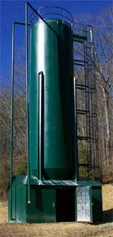
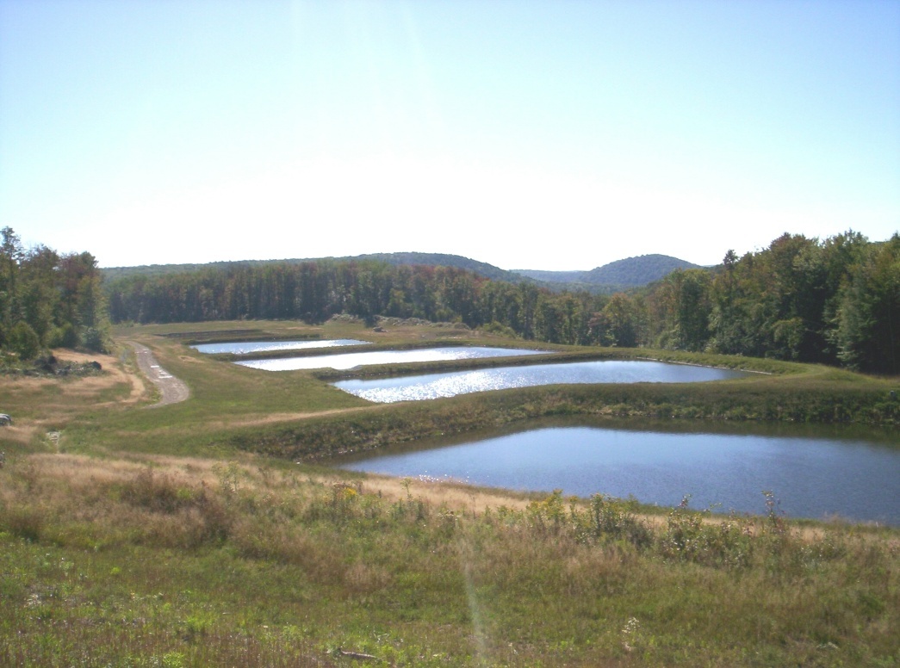
Treatment Options
There are classes of treatment
Active treatment
Passive treatment
A lime silo that is part of an active treatment faciclity. Provided by Aquafix http://www.aquafix.com/typical.htm
Passive treatment ponds in Babb Creek. Provided by TU staff.
Notes:
There are two groups of treatment Active and Passive treatment
Active treatment as it implies requires the active addition of chemicals to raise the pH
Passive treatment allows the water to passively flow over rocks and through wetlands to raise the pH and remove the metals.
Each large group of treatment has different options within the group
Each drainage requires evaluation to determine the best option for that drainage
Important points for students:
There are two types of treatment active and passive.

Slide 9
Active Treatment
Very basic chemicals such as lime, or soda ash are added to the water
The treated water then is allowed to settle so that the metals can settle out and clean water can exit the system
Some times water is treated in stream, or treated water is allowed to settle in the stream
This sacrifices the stream for the good of the receiving waterway
Notes:
Active treatment utilizes the addition of basic chemicals to the water this include lime, soda ash, sodium hydroxide or any other basic chemical that will neutralize the acid in water.
The metals in the treated water precipitate and are allowed to settle out.
The resulting water is allowed the discharged into a stream where it can support life.
In some cases there is not enough room for a treatment system. In these cases the water is treated in the stream by adding alkaline material to the stream and the metals are allowed to settle in the stream.
This sacrifices life in that stream for the health of the receiving stream, in short nothing will live in that stream but the water chemistry of the receiving stream will be improved to support life.
Important points for students:
Active treatment relies on the constant addition of chemicals to the water to treat AMD.
Questions for Students:

Slide 10
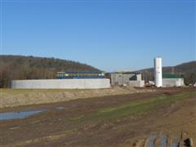
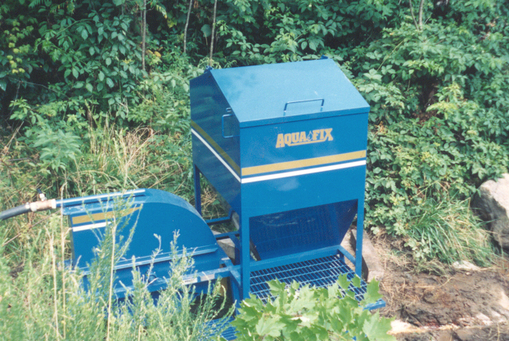
Active Treatment
Active treatment can range in size and cost
Simple water driven dosing systems
Can only treat small amounts of water
Easy to install and less expensive
Can have operation problems
Large treatment plants
Treat large quantities of water
Very expensive to install
Have high operation costs
A small lime doser that adds alkaline materials to the stream. Provided by Aquafix http://www.aquafix.com/
This large treatment facility treats large volumes of water. Provided by DEP.
Notes:
Active treatment can range in the way it adds alkalinity to the stream
These can be small dosing systems that utilize the power of the flowing water the add the chemicals to the water. Because the water drives the addition of the chemicals the dose of chemical is adapted as the flow increases or decreases. These systems are easy and the least expensive (~$50,000-$100,000) to install but need to monitored to be sure they are delivering the proper amount of chemicals
Large systems can also be built to treat large quantities of water. They can treat large volumes of highly polluted water. They are very expensive to install (>$5 million) and are very expensive to run (>$100,000).
Important points for students:
There are different types of active treatment but all rely on addition of alkaline chemicals to the water.
Questions for Students:
If large systems cost more to install and run why would they be installed?

Slide 11
Advantages/Disadvantages
Active treatment allows for adaptive treatment
Dosing systems
Less land
Are inexpensive
Large systems
Treat large volumes of water highly impaired water
Can require large upfront costs
Have large operation and maintenance costs
Notes:
Active treatment allows for adaptive treatment as flows or chemistry change the operator of the system can change the amount of chemical added to the water.
Small dosing systems take up much less land than passive treatment systems and do not cost as much as passive treatment
The larger systems can treat large quantities of water but have large upfront costs
Both forms have high operation and maintenance costs as the chemicals are used up and need to be replaces. There are many moving parts and pumps associated with the water treatment and these can easily break
Important points for students:
Active treatment has advantages and disadvantages that need to be considered during the selection of a treatment type.
Questions for Students:
Why might requiring more long-term maintenance be a bad thing?

Slide 12
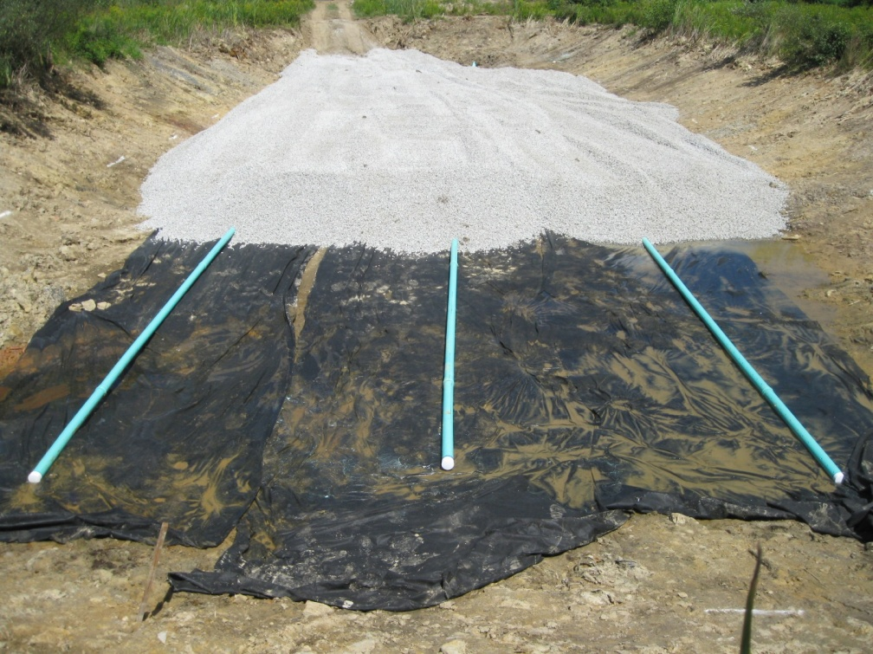
Passive Treatment
Ponds are constructed to hold the treatment cells
The pH of water is raised using basic minerals such as limestone
Bacteria are propagated with mushroom soil to remove oxygen and prevent limestone scaling
Plants remove metals and further treat the water
Each system is designed for the individual drainage
A Passive Treatment system being constructed shows the limestone that is added to the bottom of the pond. Provided by Clinton County Conservation District.
Notes:
Limestone raises the pH as the water flows over it, this allows the metals to precipitate and then settle with clean water flowing out of the ponds
Bacteria in spent mushroom soil remove the oxygen from the water and prevent metal scale from developing on the limestone
If scaling occurs it removes surface area and prevents the limestone from raising the pH
Plants further remove metals and clean the water, most of the time these plants are cattails which do a good job of removing metals as well as slowing down the treated water to allow further settling of the precipitated metals
Each system needs to be designed for the specific drainage and land that the system can be built on
Important points for students: Passive treatment utilizes limestone and plants to treat AMD.
Questions for Students:
Based on surface area What size of limestone do students think is best?

Slide 13
Passive Treatment
Prior to construction water chemistry, and flow rate are used to design the proper system
This allows for the proper system to be designed and treat the water properly
These systems can range from small wells filled with limestone to large scale systems that include many ponds and treatment types
Notes:
Each system needs to be designed based on the water chemistry, flow rate and space the system can be built on. This helps engineers design a system that will treat the water in all flow conditions in the area that is feasibly to place a system in. This means flat land with out other streams.
The systems can range from small wells which treat water that is low in pH but with out high metals to large systems that involve many ponds and many types of treatment including limestone ponds, wetlands, limestone channels and other treatment options.
Important points for students: Treatment needs to be designed for each drainage which takes a lot of design to determine which treatment is best.

Slide 14
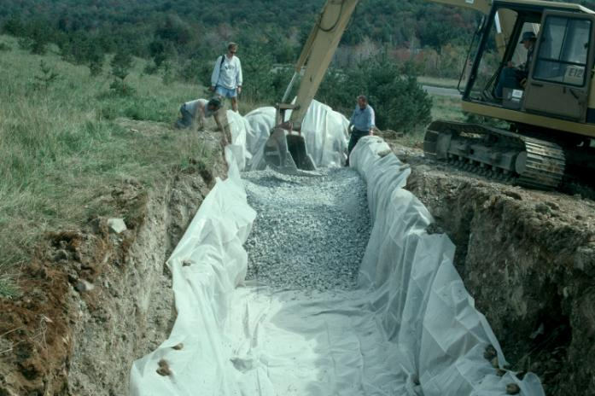
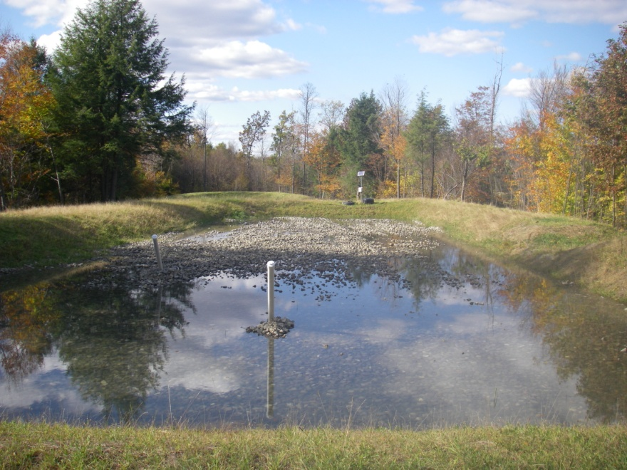
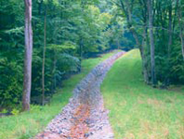
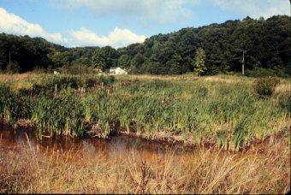
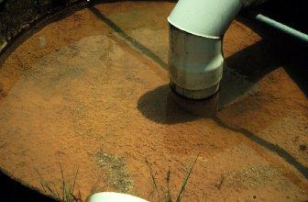
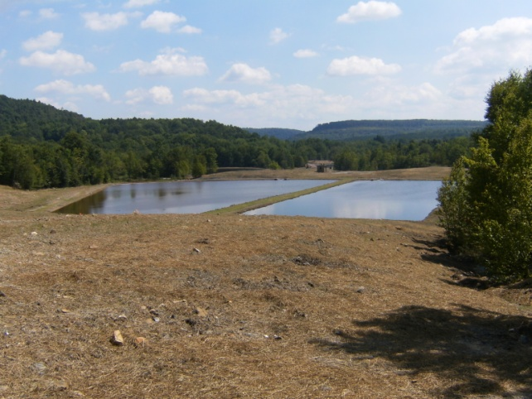
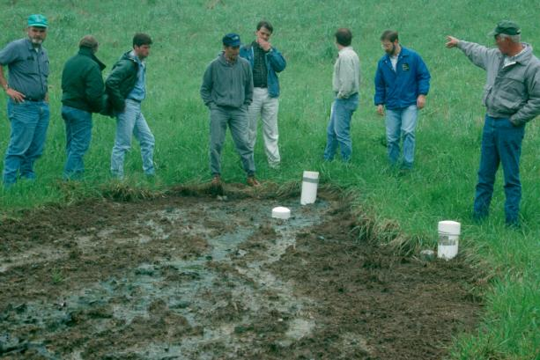
Passive Treatment
Passive treatment can utilize any combination of theses or other treatments
Constructed wetlands
Anoxic limestone drains (ALD)
Vertical Flow Ponds
Limestone ponds
Open limestone channels
Diversion wells
Diversion Well. Provided by WV University Extension http://anr.ext.wvu.edu/r/download/45372
Constructed wetland. Provided by WV University Extension http://anr.ext.wvu.edu/r/download/45372
Limestone Channel. Provided by EPA http://water.epa.gov/polwaste/nps/success319/wv_che.cfm
A limestone pond in operations. Provided by Clearfield County Clean Water Clearinghouse http://www.ettaro.com/subdomains/amd/index.php?option=com_content&view=featured&Itemid=101
Top: Anoxic limestone drain in construction. Bottom: The exit of an ALD. Provided by WV University Extension http://anr.ext.wvu.edu/r/download/45372
Top: Construction of a vertical flow pond. Provided by Clinton County Conservation District. Bottom: Two ponds in operations. Provided Susquehanna River Basin Commission.
Notes:
Treatment can involve any of these treatment types. There are other forms of passive treatment that are not discussed here. These are the most common in Pennsylvania.
Wetlands contain plants the remove metals and allow metals to settle to the bottom
Anoxic limestone drains are underground drains that add alkalinity and boost the pH with out oxygen being present. Without oxygen present the metals in the water can not scale the limestone
Vertical flow ponds are ponds force water to enter the pond on the top, then the water is drawn by gravity through mushroom compost which removes oxygen, the water then moves through limestone to pipes on the bottom of the pond that allow the water to exit. Because the water travels vertically through the pond structure they are called vertical flow ponds
Limestone ponds are simply ponds with limestone in them. These increase alkalinity and raises pH. They work well for drainages with low pH and high aluminum although they need to be flushed to remove the precipitated aluminum.
Open limestone channels are like a limestone pond but water flows through a channel that has limestone in it
Diversion wells divert a small amount of stream water into a concrete well. It mixes the water with limestone to increase alkalinity and pH.
Important points for students: There are many types of treatment all raise pH and remove metals

Slide 15
Advantages/Disadvantages
Passive treatment requires less maintenance and monitoring than active treatment
Passive treatment generally requires large areas of land
Passive treatment has mid level initial costs, but lower operation and maintenance costs
Notes:
Passive treatment requires less maintenance than active treatment. Generally every 5 years maintenance is needed.
Monitoring is also less for passive treatment, at most once a month. Active treatment should be monitored at least ever other week and many times once a week.
Passive treatment requires large areas of flat land to treat the water in ponds
Passive has a mid-level initial cost and low operation and maintenance costs as the materials are slowly used up and there are few to no moving parts.
Important points for students:
Passive treatment has many advantages and disadvantages and each discharge needs to be evaluated.
Questions for Students:

Slide 16
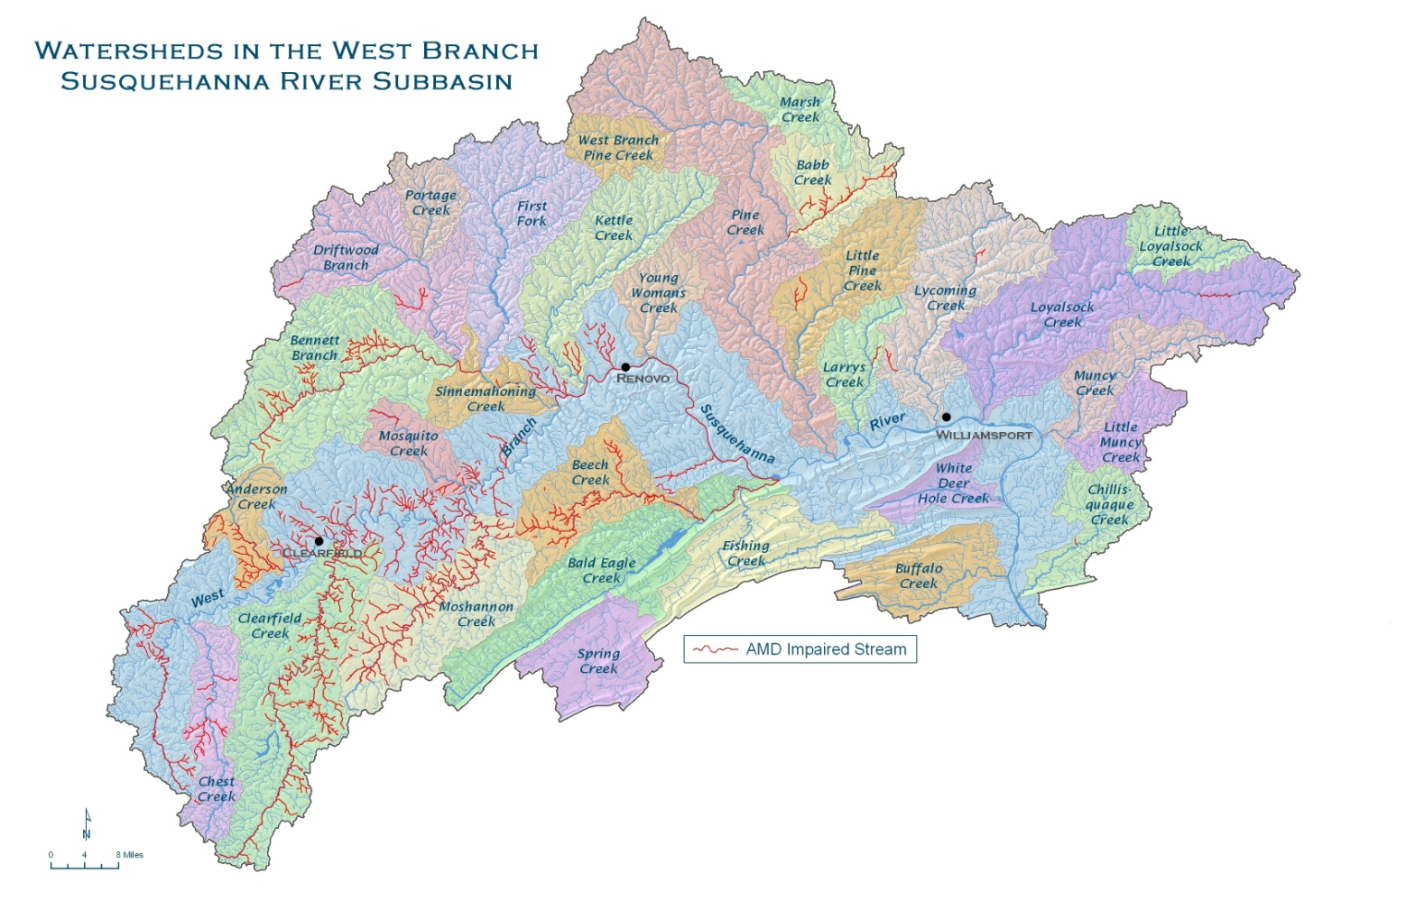
A Success Story
Babb Creek is a sub-watershed of the Pine Creek Watershed in Tioga County
Mining in the watershed started at the end of the Civil War and was completed by the mid 20th century
By the mid 1900’s Babb Creek was labeled as impaired and was considered dead
Notes:
Babb Creek is a sub-water located in Tioga County. It leads to Pine Creek which enters the West Branch of the Susquehanna River near Jersey Shore
Mining in the watershed started early, at the end of the Civil War. All mining was complete prior SMCRA being passed.
By the mid 1900’s Babb Creek had been added to the state’s impaired waters list and was written off as dead. Most people thought the stream would remain dead. The stream was severely impaired with many drainages that seemed untreatable.
Additions:
Have students read about Babb Creek and the work of the volunteers by reading…

Slide 17
Babb Creek’s Restoration
In 1990 concerned citizens formed the Babb Creek Watershed Association (BCWA)
BCWA worked with other organization to locate sources of pollution and evaluate them for treatment
In 2004 BCWA along with many partners constructed the largest passive treatment system in the world
Notes:
In 1990 citizens formed the Babb Creek Watershed Association (BCWA).
The group worked with other organizations to locate all of the sources of pollution and evaluate them for treatment.
The group worked to build treatment systems that many people felt would never work
This included building the largest passive treatment system in the world names Anna S after the mine that caused the drainage.

Slide 18
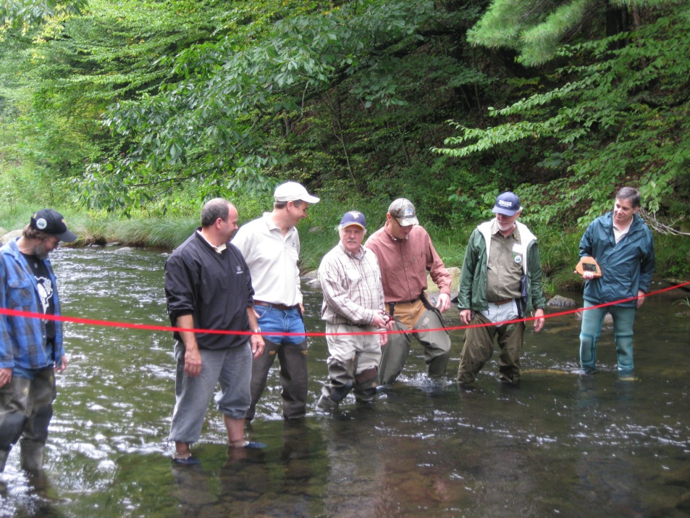
The Return of Babb Creek
By 2009 sixteen projects had been completed on Babb Creek
14 miles of Babb Creek along with 5 miles of Pine Creek were removed from the impaired waters lists
Fish now can be caught in Babb Creek due to the dedicated efforts of BCWA volunteers
Ribbon cutting ceremony for the removal of Babb Creek from the impaired waters list. Provided by TU Staff.
Notes:
After nearly 20 years of work the group finally got what it was working for and after completing 16 projects 14 miles of Babb creek and 5 miles of Pine creek were removed from the impaired streams list.
After the years of dedicated efforts the citizens that started BCWA are able to catch fish in their stream. The systems will require regular maintenance but should continue to treat the water and allow fish to survive for years to come.

